Slide 1
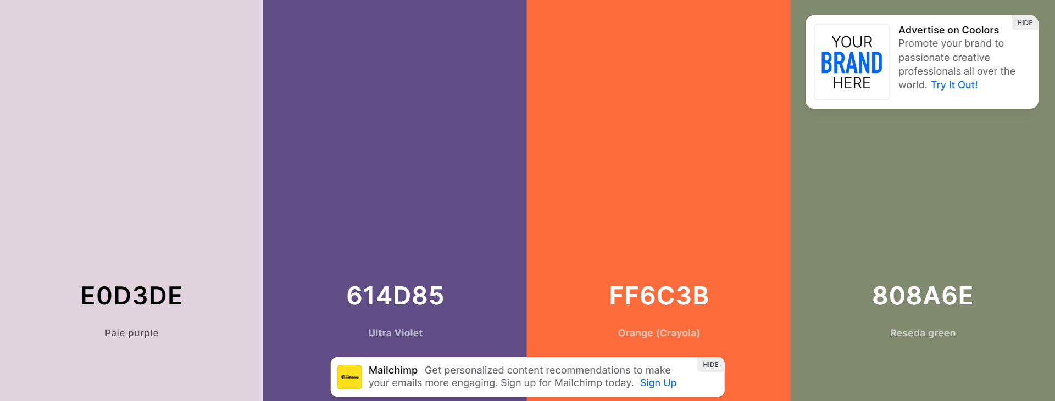
E0D3DE
614D85
FF6C3B
808A6E

Slide 3
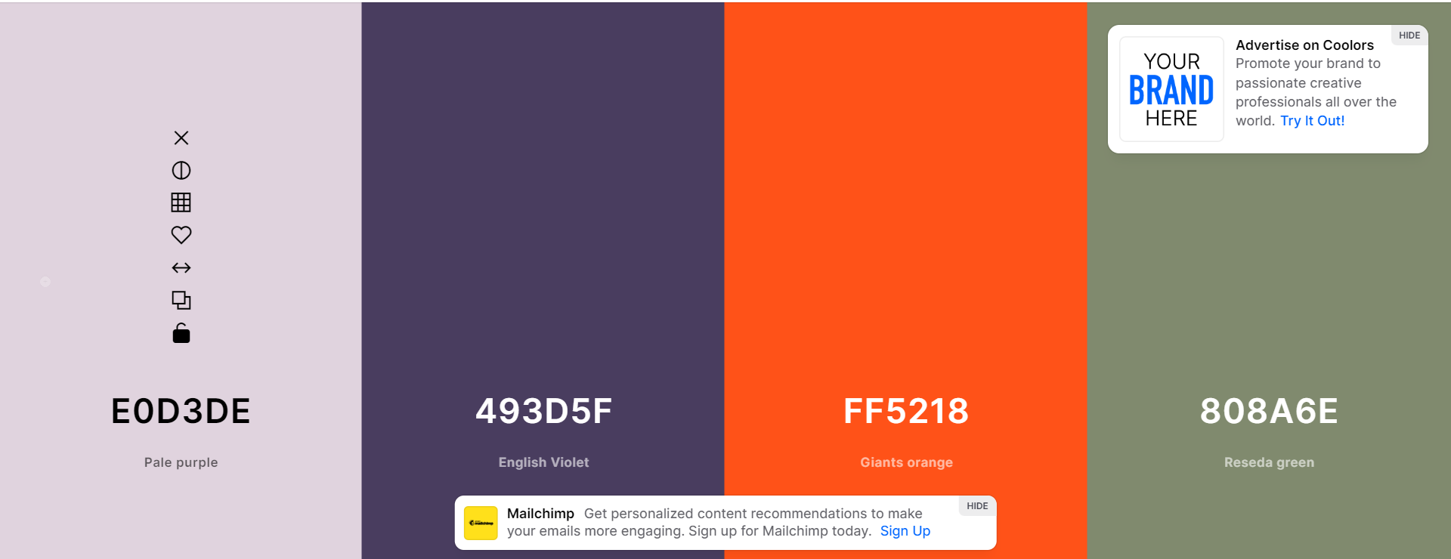
#E0D3DE
#493D5F
#FF5218
#808A6E

Slide 4
HOME
ABOUT MY WORK CONTACT
TEXTE INTRO
Animation typing ?
About me

